Slide 1

Noida Institute of Engineering and Technology, Greater Noida
Waste Load Energy Sustainability
Unit: 5
Sustainable Technologies
AOE0866
ANAMIKA SRIVASTAVA
Assistant Professor
IT & M.Tech Integ.
CSE 8TH SEM

Slide 2
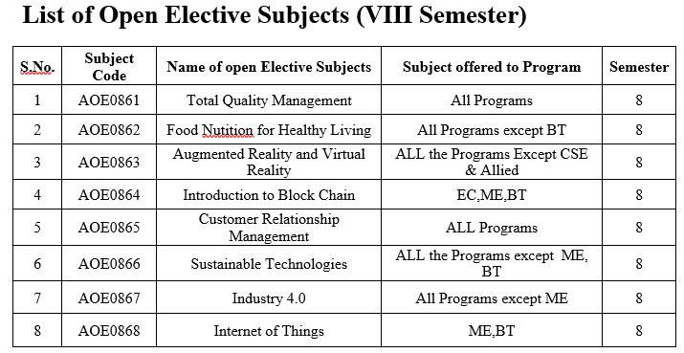
Evaluation Scheme

Slide 3
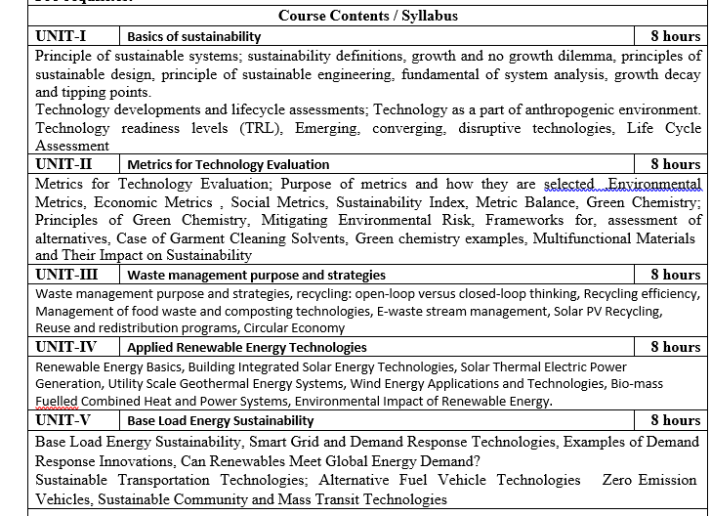
Syllabus

Slide 4
Branch wise Application
First, we will start with the internet which is very much important for our daily life and we cannot even imagine our life without the internet and it is the outcome of clever and creative algorithms. Numerous sites on the internet can operate and falsify this huge number of data only with the help of these algorithms.
The everyday electronic commerce activities are massively subject to our data, for example, credit or debit card numbers, passwords, OTPs, and many more. The centre technologies used incorporate public-key cryptocurrency and digital signatures which depend on mathematical algorithms.
Even an application that doesn't need algorithm content at the application level depends vigorously on the algorithm as the application relies upon hardware, GUI, networking, or object direction and all of these create a substantial use of algorithms.
There are some other vital use cases where the algorithm has been used such as if we watch any video on YouTube then next time we will get related-type advice as recommended videos for us.

Slide 5
Course Objective
Upon completion of this course, students will be able to do the following:
Analyze the asymptotic performance of algorithms.
Write rigorous correctness proofs for algorithms.
Demonstrate a familiarity with major algorithms and data structures.
Apply important algorithmic design paradigms and methods of analysis.
Synthesize efficient algorithms in common engineering design situations.

Slide 6
Course Outcome
At the end of the semester, the student will be able:
 | Description | Bloom’s Taxonomy
CO1 | Understand the principles of sustainable systems and demonstrate how the economic and technical performance of sustainable technologies can be measured and compared | UNDERSTAND
CO2 | Identify the technical and economic obstacles to the widespread use of sustainable technologies | APPLY
CO3 | Assess sustainable technologies to show the greatest long-term promise in terms of social, environmental, and economic metrics. | UNDERSTAND
CO4 | Identify types of sustainable energy technologies that are closest to commercialization | APPLY

Slide 7
Program Outcome
At the end of the semester, the student will be able:
POs | Engineering Graduates will be able to
PO1 | Engineering Knowledge
PO2 | Problem Analysis
PO3 | Design & Development of solutions
PO4 | Conduct Investigation of complex problems
PO5 | Modern Tool Usage
PO6 | The Engineer and Society
PO7 | Environment and sustainability
PO8 | Ethics
PO9 | Individual & Team work
PO10 | Communication
PO11 | Project management and Finance
PO12 | Life Long Learning

Slide 8
CO-PO and PSO Mapping
SUSTAINABLE TECHNOLOGY AOE0866
CO | PO1 | PO2 | PO3 | PO4 | PO5 | PO6 | PO7 | PO8 | PO9 | PO10 | PO11 | PO12 | AVG
AOE0866.1 | CO1 | 3 | 2 | 2 | 2 | 2 | 1 | 3 | 1 | 1 | 2 | 2 | 2
AOE0866.2 | CO2 | 2 | 3 | 2 | 2 | 2 | 2 | 3 | 1 | 1 | 1 | 2 | 2
AOE0866.3 | CO3 | 2 | 2 | 3 | 2 | 2 | 2 | 3 | 2 | 1 | 2 | 2 | 2
AOE0866.4 | CO4 | 2 | 2 | 3 | 2 | 3 | 2 | 3 | 1 | 1 | 2 | 2 | 2
AVG |  | 2.25 | 2.25 | 2.5 | 2 | 2.25 | 1.75 | 3 | 1.25 | 1 | 1.75 | 2 | 2

Slide 9
Program Educational Objectives(PEOs)
PEO1: To have an excellent scientific and engineering breadth so as to
comprehend, analyze, design and provide sustainable solutions for
real-life problems using state-of-the-art technologies.
PEO2:To have a successful career in industries, to pursue higher studies or
to support enterpreneurial endeavors and to face global challenges.
PEO3:To have an effective communication skills, professional attitude,
ethical values and a desire to learn specific knowledge in emerging
trends, technologies for research, innovation and product
development and contribution to society.
PEO4: To have life-long learning for up-skilling and re-skilling for
successful professional career as engineer, scientist, enterpreneur
and bureaucrat for betterment of society

Slide 10
End Semester Question Paper Template
B TECH
(SEM-V) THEORY EXAMINATION 20__-20__
DESIGN AND ANALYSIS OF ALGORITHMS
Time: 3 Hours Total Marks: 100
Note: 1. Attempt all Sections. If require any missing data; then choose suitably.
SECTION A
Attempt all questions in brief. 2 x 10 = 20
Q.No. | Question | Marks | CO
1 |  | 2
2 |  | 2
. |  | .
10 |  | 2

Slide 11
End Semester Question Paper Templates
SECTION B
2. Attempt any three of the following: 3 x 10 = 30
SECTION C
3. Attempt any one part of the following: 1 x 10 = 10
Q.No. | Question | Marks | CO
1 |  | 10
2 |  | 10
. |  | .
5 |  | 10
Q.No. | Question | Marks | CO
1 |  | 10
2 |  | 10

Slide 12
End Semester Question Paper Templates
4. Attempt any one part of the following: 1 x 10 = 10
5. Attempt any one part of the following: 1 x 10 = 10
6. Attempt any one part of the following: 1 x 10 = 10
Q.No. | Question | Marks | CO
1 |  | 10
2 |  | 10
Q.No. | Question | Marks | CO
1 |  | 10
2 |  | 10
Q.No. | Question | Marks | CO
1 |  | 10
2 |  | 10

Slide 13
Unit Objective
Sustainable waste management aims to keep materials in use for as long as possible and minimize the amount of solid waste that is disposed of in landfill or through incineration. However, in our existing linear economy, waste begins even before products are manufactured, and a more in-depth approach to sustainable waste management must focus on the entire lifecycle of a product to enable us to help reduce the negative environmental, social, and financial impacts of 21st-century consumption.
The question then, of what exactly is sustainable waste management, is important if we are to refine and improve our existing waste management systems. Whether focusing on waste reduction at end-of-life or designing waste out of the production cycle at the conceptual stage, new waste management practices are required to effectively deal with existing waste streams while also reducing the amount of waste at the same time.
.

Slide 14
Base Load Energy Sustainability
Base load power sources are the plants that operate continuously to meet the minimum level of power demand 24/7. Base load plants are usually large-scale and are key components of an efficient electric grid. Base load plants produce power at a constant rate and are not designed to respond to peak demands or emergencies. The base load power generation can rely on both renewable or non-renewable resources.
Non-renewable resources (fossil fuels) include: coal, nuclear fuels. Renewable resources include: hydropower, geothermal heat, biomass, biogas, and also a solar thermal resource with associated energy storage.
Typically, the power demand varies cyclically from day to day, reaching maximum during day business hours and dropping to minimum during late night and early morning, but never dropping below a certain base. (Figure 9.1) This base load is typically at 30-40% of the maximum load, so the amount of load assigned to base load plants is tuned to that level. The above-base power demand (above the base) is handled by intermediate and peak power plants, which are also included to the grid. The main advantages of the base load power plants are cost efficiency and reliability at the optimal power levels. The main disadvantages are slow response time, lack of fuel flexibility, and low efficiency when operated below full capacity.

Slide 15
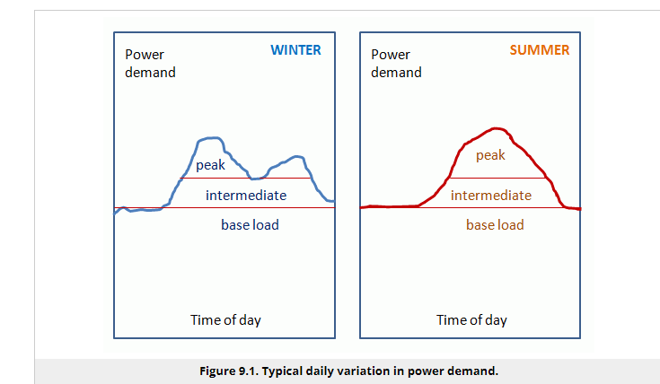
Base Load Energy Sustainability

Slide 16
Base Load Energy Sustainability
Base load plants (as well as other energy converting facilities) are characterized by a nominal capacity rating. For example, if a plant rated at 1000 MW, it means it can generate 1000 MWh of electricity per hour when working at full capacity. The actual generation can be less, depending on the demand or operating conditions, and can be characterized by the capacity factor (CF):
CF = [actual generated output] / [maximum possible output]

Slide 17
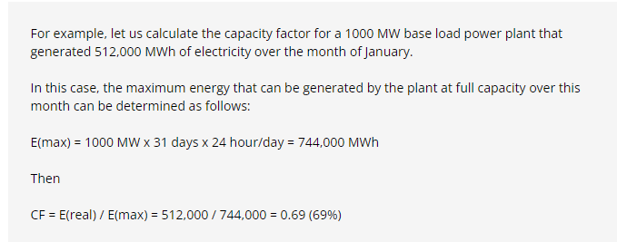
Base Load Energy Sustainability

Slide 18
Base Load Energy Sustainability
There are the number of reasons why a plant can have lower than 100% capacity factor. Some of them are:
lower demand for electricity over certain periods of time;
under-capacity operation due to maintenance;
equipment failures / interruptions;
resource/fuel shortage;
equipment upgrade (resulting in high nominal capacity).
The base load power plants typically are coal-fueled or nuclear plants due to low-cost fuel and steady state power they can produce. Hydropower and geothermal power can also be used for base load electricity generation if those resources are regionally available.
The renewable energy systems, such as solar and wind, are most suitable for intermediate load plants. These are intermittent energy sources, with their output and capacity factor depending on weather conditions, daily, and seasonal variations. So, unless there is an effective energy storage system in place, they cannot be relied upon to meet constant electricity supply needs, nor can they be immediately employed to respond to peak demands. However, as intermediate sources, solar and wind systems can be efficient and can help reduce dependence on fossil fuels.

Slide 19
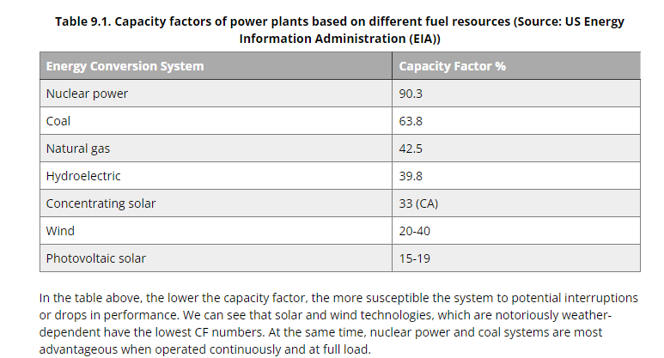
Base Load Energy Sustainability

Slide 20
Smart Grid And Demand Response Technologies
National electric power infrastructure, also called “the grid”, has been developing over more than a century and plays an important role in the nation’s energy security (Figure 9.2). Electricity production traditionally relies on a steady fuel supply (primarily fossil fuels), which would keep the power plants operating on the permanent basis. Eventual switching from the traditional fuel-burning plants to cleaner alternatives requires redesigning the grid in such a way that it properly responds to the sharp variations in demand, adequately compensates for the intermittent operation of the renewable energy systems, and can interact with distributed power generation systems.

Slide 21
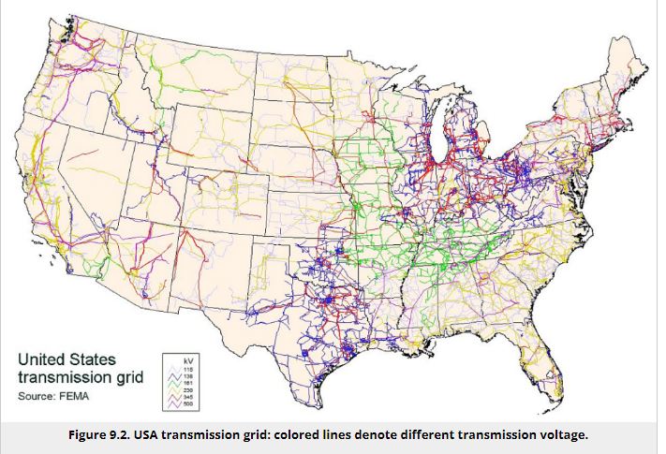
Smart Grid And Demand Response Technologies

Slide 22
Smart Grid And Demand Response Technologies
The transmission grid shown in the figure above shows the interconnection of power generating facilities with distribution sub-stations. The local distribution grid is designed to supply power to end users and usually has a radial structure. While some of the components of the grid are subject to renovation, it is not the physical structure of the grid that is the focus of current redesign efforts; it is the informatics component that is supposed to bring the grid to a new level of intelligence. Hence, the interactive combination of information technologies and transmission systems creates the smart grid system.

Slide 23
Smart Grid And Demand Response Technologies
Introduction of the demand response technologies is especially relevant to the power supply for buildings. According to US DOE (DOE 2007), buildings in the US consume around 72% of total electricity, and sensitive regulation of building energy demand is considered a major factor in sustainable development. Transitioning buildings to the smart grid is a complex task, which requires efforts in three areas:
legislation to mandate the government and business actions;
standard and technologies enabling building-utility communications;
business model to balance the demand-response interactions. The following article describes how these three factors can be synergistically combined to radically change the way building electricity use is managed.

Slide 24
Examples Of Demand Response Innovations
The demand response business models are currently being developed by many companies. Those models require all-system analysis, since successful feedback between the different actors is key to effective operation. Behavioral aspects are seriously considered because they eventually control the decision-making on both sides of the utility-customer chain.
Below are links to some recent studies and pilot programs that seek to promote a demand response approach in power management. Please look through those examples and take a note which parties actually benefit from implementation of those approaches. Are there economic drivers behind them?
Jeff St. John, Innovari Wants to Make Demand Response the Same As an Independent Power Plant(link is external), June 9, 2014
Stephen Lacey, Opower Expands Behavioral Demand Response to 1 Million Customers(link is external), May 20, 2014.
Severin Borenstein, Peak-Time Rebates (PTR): Money for Nothing?(link is external), May 12, 2014
Jeff St. John, Tendril Is Back: Could Nest and SolarCity Benefit From Its Microtargeting Model?(link is external), May 7, 2014.
The activity in the end of this lesson will involve assessment of demand response technologies, so the above-listed reports may be useful illustrations for that assignment.

Slide 25
Can Renewable Energy Meet Global Demand ?
Renewable capacity will meet 35% of global power generation by 2025, according to the International Energy Agency (IEA).
The organization also says electricity demand is forecast to grow by 3% a year over the next three years compared to 2022, with a third of global consumption in China.
The Energy Information Administration predicts that solar power will make up more than half of new capacity in the US in 2023.

Slide 26
Can Renewable Energy Meet Global Demand ?
A significant rise in CO2 emissions from the global power sector is unlikely over the next few years, thanks to the rapid rise in renewable energy capacity.
That’s one of the key findings from the International Energy Agency’s (IEA) Electricity Market Report 2023. It predicts that renewable energy sources such as solar and wind power, together with nuclear, will on average meet more than 90% of the increase in global demand by 2025.
“The good news is that renewables and nuclear power are growing quickly enough to meet almost all this additional appetite, suggesting we are close to a tipping point for power sector emissions,” says IEA Executive Director Fatih Birol.
“Governments now need to enable low-emissions sources to grow even faster and drive down emissions so that the world can ensure secure electricity supplies while reaching climate goals,” he warns.

Slide 27
Can Renewable Energy Meet Global Demand ?
The IEA forecasts that global electricity demand is expected to rise by 3% per year over the 2023-2025 period, compared with the 2022 growth rate.
More than 70% of this is expected to come from China, Southeast Asia and India, the report says. However, advanced economies are looking to generate more electricity, as well as reduce reliance on fossil fuels in sectors like heating and transportation.
“By 2025, for the first time in history, Asia will account for half of the world’s electricity consumption and one-third of global electricity will be consumed in China… over the next three years the electricity consumption added each year is roughly equivalent to that of the United Kingdom and Germany combined,” the report says.

Slide 28
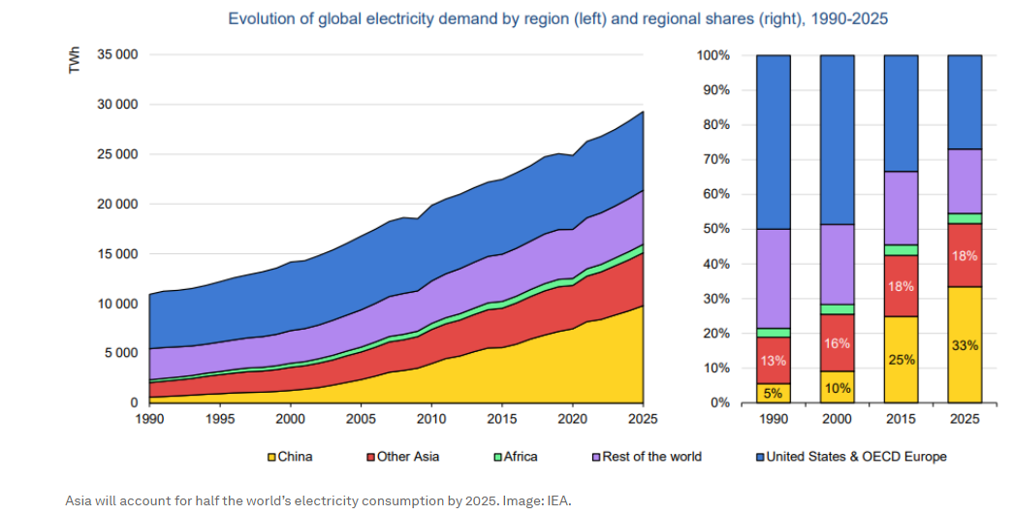
Can Renewable Energy Meet Global Demand ?

Slide 29
Can Renewable Energy Meet Global Demand ?
A renewables boost
Renewables’ share of the power generation mix worldwide is set to rise from 29% to 35% by 2025, according to the IEA. The share of coal and gas-fired generation will consequently fall, it says. And so will global power-sector CO2 emissions, which are predicted to plateau through to 2025, despite reaching an all-time high in 2022 of about 13.2Gt CO2.
China will account for close to half of the additional renewable generation, followed by the European Union with 15%, the IEA says. This growth is being fuelled by increased government spending on renewables as part of economic recovery plans, the report explains. In the US, alone, the Inflation Reduction Act will provide $370 billion in clean energy investments.
Nuclear output is expected to grow on average by around 3.6% a year. This will come from the anticipated recovery in nuclear generation in France, as scheduled maintenance is completed. New plants will also come online, mainly in Asia, the report says.

Slide 30
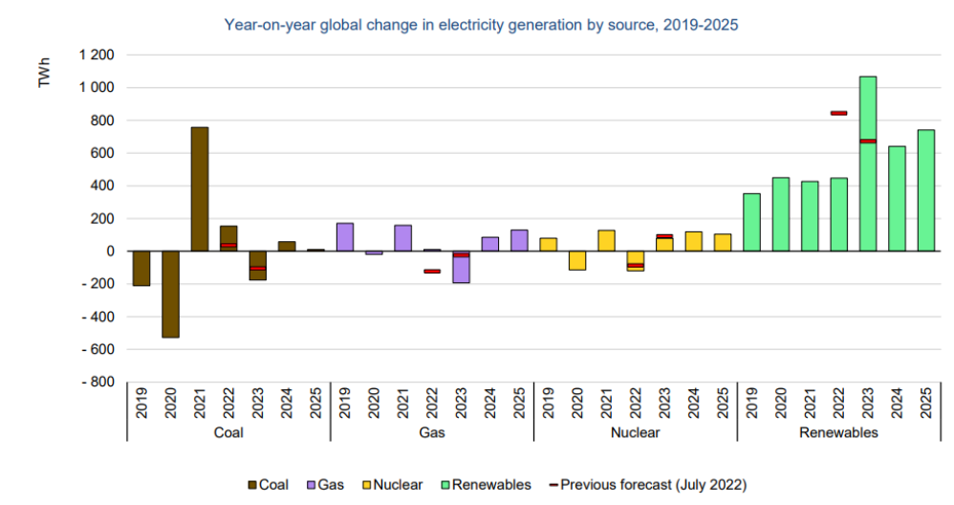
Can Renewable Energy Meet Global Demand ?

Slide 31
Sustainable Transportation Technologies
Sustainable transportation refers to not only vehicles, but also includes fuels, infrastructure to deliver distribute these fuels (pipelines, stations), road networks and railways. Assessment of the transportation system needs to address the system effectiveness to meet society needs and environmental load associated with employed vehicles and infrastructures. This lesson overviews three important topics: alternative fuels and their associated impacts, zero-emission vehicles and status of electric vehicle technologies, and perspectives of the mass transit in sustainable community.

Slide 32
Sustainable Transportation Technologies
Alternative Fuel Vehicle Technologies
Let us start with some facts (Source: Sierra Club, 2014):
Every day, the U.S. uses ~400 million gallons of oil to move people, goods, and vehicles.
There are ~230 million gasoline-fueled vehicles in the U.S. that travel average 12,000 miles per year.
About 70% of all oil used in the U.S. is used for transportation.
About 70% of all oil used in the U.S. is imported from the countries at "high risk" of instability.
Every day, the U.S. sends about $1 billion abroad for oil expenses.
While the demand for transportation fuels is increasing, the continuing dependency of the U.S. economy on the foreign oil has put the country in an extremely vulnerable position with respect to meeting its transportation energy needs. This vulnerability is the critical motivator in searching for alternative fuels for vehicles and looking for alternative types of transportation as well. Sustainability of transportation basically means the flexibility and ability to provide for your own needs using the resources that are local, widely available, or renewable. What are the options there?

Slide 33
Sustainable Transportation Technologies
A number of alternatives (including both liquid and gaseous transportation fuels) have been a subject of research and implementation for the last few decades. Let us review the background behind those options. Click on the following links to read about the various classes of alternative fuels considered for transportation purposes:
Biofuels(link is external) (biodiesel, ethanol)
Natural gas (NGV)(link is external)
Hydrogen(link is external)
Electricity(link is external)
All of the alternative fuels have their current advantages and disadvantages, which are briefly summarized in US DOE Data Table (U.S. DOE, 2007).
Please note, the second row of this table shows an important metric used to characterize fuels (not only transportation fuels) - energy content or energy density. It is measured in energy units per unit volume or unit mass of the fuel. For example, from the data in the table, we can see that diesel and biodiesel fuels provide the highest amount of energy compared to other liquid fuels.

Slide 34
Sustainable Transportation Technologies
Alternative fuel supply chain and distribution
Viability of certain types of transportation fuels is closely related to the processing, supply, and distribution infrastructure. This is especially critical in the U.S. society and economy, which are heavily reliant on the usage of road vehicles for personal and industrial needs.
The following reading will introduce you to the strategies and facts associated to the transportation liquid fuel supply chains. This covers both existing renewable and non-renewable fuel infrastructures:

Slide 35
Sustainable Transportation Technologies
Transportation Emissions
Strong motivators for developing alternative vehicle technologies and fuels are growing emissions and alarming urban air pollution levels. According to US EPA, in 2017, CO₂ emissions from transportation sector surpassed the long-time leader – electric power sector – in the total national emissions budget. This change in “leadership” in part happened due to increasing addition of natural gas and renewable sources to the power generation mix while retiring older coal power plants in a number of states. Here is how the last half-decade of CO₂ data looks like:

Slide 36
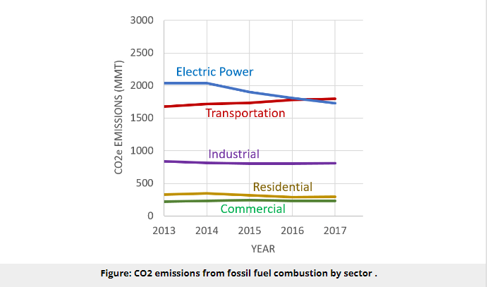
Sustainable Transportation Technologies

Slide 37
Sustainable Transportation Technologies
It is also estimated by EPA that nearly 60% of those transportations emissions in the United States come from passenger vehicles – cars, SUVs, and pickup trucks. There are economic reasons for that growth. In the late 2000s, the automobile emissions were moderated by the policies adopted by the Obama administration, which limited the amounts of gasoline the vehicles were supposed to use per mile. The Trump administration initially aimed at elimination of those fuel efficiency standards, which would most likely push future transportation emissions up. However, the proposal was recently revised, and after receiving comments from industry and public, the government did not eliminate the Obama standards, but adjusted them, to enforce only 1.5% annual MPG increase for passenger vehicles (as opposed to 5% under Obama regulation). The main argument for this change was that less stringent standards would make new cars more affordable, and thus increase driving safety for the families who would be otherwise be forced to drive older cars (USA Today(link is external)).

Slide 38
Sustainable Transportation Technologies
Zero Emission Vehicles
The concept of zero-emission vehicles is typically attributed to the transportation options that do not result in any harmful emissions during vehicle operation. Harmful emissions are defined as those known to have a negative impact on the environment or human health. They can include carbon dioxide, carbon monoxide, nitrogen and sulfur oxides, ozone, various hydrocarbons, volatile organic compounds (VOC), heavy metals in volatile forms (e.g., lead, mercury, etc.), and particulate matter.
Typical examples of zero-emission vehicles are electric (battery-powered) cars, electric trains, hydrogen-fueled vehicles, and human / animal powered transportation (e.g., bicycles, velomobiles, carriages, etc.). The battery technology for electric vehicles is based on charge/discharge cycles, meaning that the battery is charged beforehand using an electricity source and is discharged during vehicle operation. Because electricity production may involve some emissions, there is also a concept of well-to-wheel emissions, which includes not only operating emissions, but also those associated with the fuel source and other stages of the vehicle operating cycle. So, the "zero-emission" term is conditional in that sense.

Slide 39
Sustainable Trasportation Technologies
The hydrogen-fueled vehicles are typically based on fuel cell technology, which imply electrochemical conversion of the fuel energy into electricity (as opposed to combustion). As a result, the only emissions of fuel cell operation are water and heat, which are not classified as harmful and therefore allow placing the fuel cell transport vehicles in the zero-emission category. The same as electric vehicles, fuel cell vehicles shift the emissions to the stage of fuel production. Thus, manufacturing of hydrogen gas via reforming of natural gas results in CO₂ emissions, which must be taken into account in the life cycle assessment.

Slide 40
Sustainable Transportation Technologies
However, there is a possibility of designing a sustainable zero-emission lifecycle for electric and hydrogen vehicles, if electricity for recharging the batteries is supplied from renewable sources such as wind, solar, hydro-power converters, and the hydrogen to power fuel cells is produced via electrolysis or other emission-free technologies.
The energy conversion technologies that support the electric vehicles rely heavily on special chemistry and materials necessary to facilitate the efficient charge transfer processes. Understanding the components and principle of those technologies is important to foresee potential barriers on the way to their wide implementation and commercialization. The following learning materials will provide you with the basic knowledge on how the battery and fuel cell systems work.

Slide 41
Sustainable Transportation Technologies
Li-ion battery technology for cars
A schematic representation of a generic Li-ion battery is given in Figure 10.1. Roughly, Li-ion cell consists of three layers: electrode 1 (cathode) plate (usually lithium cobalt oxide), electrode 2 (anode) plate (usually carbon), and a separator. The electrodes inside the battery are submerged in an electrolyte, which provides for Li+ ion transfer between the anode and cathode. The electrolyte is typically a lithium salt in an organic solvent.

Slide 42
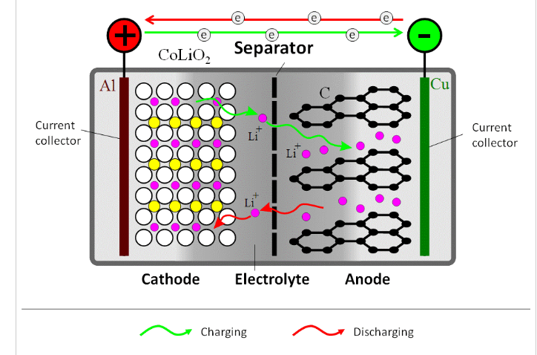
Sustainable Transportation Technologies

Slide 43
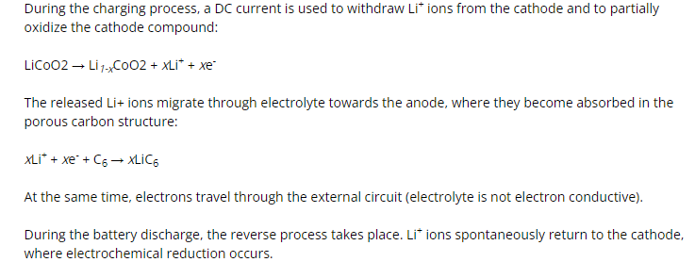
Sustainable Transportation Technologies

Slide 44
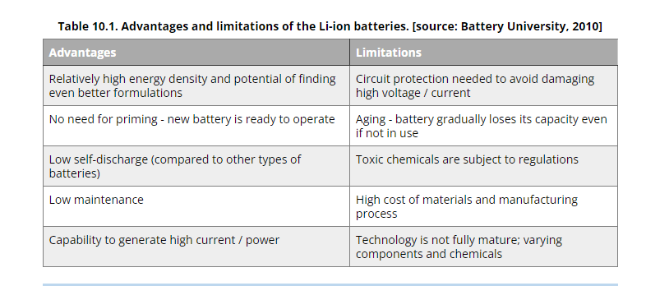
Sustainable Transportation Technologies

Slide 45
Sustainable Transportation Technologies
Fuel Cell Technology for Cars
Fuel cell is similar to a battery in the electrochemical principle of energy conversion, but different in operational design. Instead of storing the reagents and products of chemical reactions inside, like batteries do, fuel cells operate on continuous inflows/outflows of reagents and products. In that sense, they are not limited by discharge time and can generate electricity non-stop as long as fuel is supplied. Hydrogen is the best-proven fuel for fuel cells, although its storage and supply imposes some constraints on this technology.
A schematic representation of a hydrogen/oxygen fuel cell is given in Figure 10.2. The main components of the fuel cell include: membrane electrode assembly, which consists of a proton-exchange membrane and electrodes (anode and cathode) attached to the membrane on each side, gas diffusion layers, bipolar plates, and supporting structure. The fuel cell electrodes contain dispersed catalyst particles (usually platinum), which are necessary to promote electrochemical reaction.

Slide 46
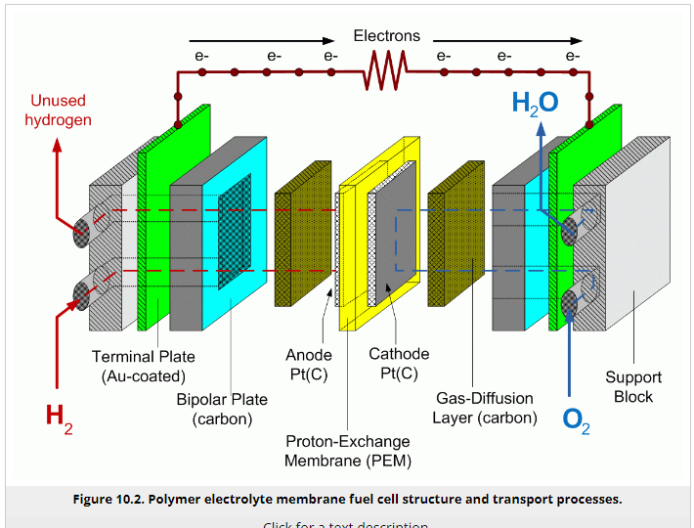
Sustainable Trasportation Technologies

Slide 47
Sustainable Trasportation Technologies
A hydrogen-powered fuel cell combines hydrogen with oxygen in the electrochemical reaction to produce water and electricity. In case of direct contact of these gases, the reaction H₂ + ½ O₂ = H₂O is very active and generate significant amount energy (under certain conditions – explosion). In a fuel cell, hydrogen is separated from oxygen by a proton conductive membrane, so, in order to react, it is forced to transform into ionic form by losing electrons:
H₂ -> 2H⁺ + 2e⁻ - this reaction occurs on the cell anode.
Further, the formed hydrogen ions (protons) are transferred through the proton-exchange membrane, while electrons are transferred through the external circuit, where they can be harvested as electric current. Once reaching the cathode, protons (H⁺) react with oxygen molecules, consuming electrons from circuit and producing water:
2H⁺ + ½O₂ + 2e⁻ -> H₂O - this reaction occurs on the cell cathode.
As long as the supply of reagents, hydrogen and oxygen gases is maintained, the process continuously generates electric energy and water.

Slide 48
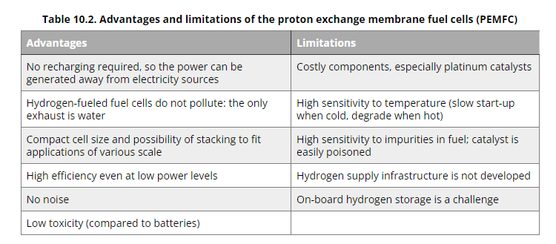
Sustainable Trasportation Technologies

Slide 49
Sustainable Trasportation Technologies
Sustainable Community and Mass Transit Technologies
Sustainable community is a term usually applied to a certain inhabited entity, a neighborhood, a town, or a city that is economically, socially, and environmentally healthy and resilient. The typical feature of a sustainably developing community is a holistic approach to meeting the local society needs, as opposed to fragmented efforts, which focus on one specific need and ignore others. Ideally, a sustainable community should have a better quality of life, which is built upon responsible and organized citizenship of its members (not on businesses compromising well-being of other communities. A sustainable community also provides economic security through reinvestments in the local economy, diverse and financially viable economic base, sustainable business (PCSD, 1997). The National Partnership for Sustainable Communities defined six principles of livability that make a community sustainable (PSC, 2014):

Slide 50
Sustainable Trasportation Technologies
Provide more transportation choices.
Promote equitable, affordable housing.
Enhance economic competitiveness.
Support existing communities.
Coordinate policies and leverage investment.
Value communities and neighborhoods.
Availability of transportation choices is the number one factor mentioned on this list. It is interesting that transportation is one thing that becomes worse with economic growth. Other important parts of society development, like information, sanitation, manufacturing, and energy efficiency typically improve with economic development, but not transport. And now, especially, development of new mass transit options become a significant part of plans of orienting communities towards sustainable development.

Slide 51
Sustainable Trasportation Technologies
Urban communities are essentially shaped by their transportation systems. Mainstream city planning in the U.S. has been based on the networks of motor roadways and personal car use, with public transit as second priority. In the second half of the 20th century, the car use and automotive fuel consumption steeply increased, as did greenhouse gas emissions from the transportation sector (~20-25% of world energy consumption). The sustainability of the current communities that are heavily reliant on car transportation becomes questionable for at least two reasons:
environmental impact - greenhouse gas emissions, air pollution, depletion of petroleum resource, increased land and water use demands; and
social impact - overdependence on cars for basic needs and commuting, limited infrastructure to support growing car culture, decreased quality and aesthetics of urban life.

Slide 52
Sustainable Trasportation Technologies
Development trends were slightly different in Asia and Europe, where planning was influenced by lower availability of resources or land required for automotive culture. Traditionally, European culture is more reliant on mass transit and has invested more into it. Thus, the International Association of Public Transport (UITP) based in Brussels, Belgium, supports a holistic approach to urban transportation and advocates public transportation development in 92 countries worldwide [Source: Wikipedia / International Association of Public Transport(link is external)]. On the average, transport emissions of a U.S. city are about 4 times higher than that in Europe and about 24 times higher than that in Asia (UITP, 2014).

Slide 53
MCQS
1. What do you mean by the term 'sustainability'?
It is the study of how natural systems functions and remain diverse and produce everything it needs for the ecology to remain in balance
It is the capacity to do the work required for all life processes
It is the study which is also termed energy conversion, which is the process of changing energy from one of its forms to another
None of the above
2. Which of the following is considered the pillar of sustainability?
Economic development
Social development
Environmental protection
All of the above
Answer: D) All of the above

Slide 54
MCQS
3. ____ is about giving people what they want without compromising their quality of life.
Economic development
Social development
Environmental protection
None of the above
Answer: A) Economic development
4. ___ defines how we should study and protect the ecosystem, air quality, integrity, and sustainability of our resources.
Economic development
Social development
Environmental protection
None of the above
Answer: C) Environmental protection

Slide 55
MCQS
5. Which of the following is the primary goal of sustainability?
The end of poverty and hunger
To achieve gender equality
To include the health of the land, air, and sea
All of the above
Answer: D) All of the above
6. Which of the following is a type of non-renewable resource?
Nuclear energy
Solar energy
Geothermal energy
Hydrogen and fuel cells
Answer: A) Nuclear energy

Slide 56
MCQS
7. Which of the following is energy relies on the nuclear fusion power from the core of the sun?
Hydroelectric energy
Solar energy
Geothermal energy
Hydrogen and fuel cells
Answer: B) Solar energy
8. Which form of energy uses the gravitational potential of elevated water which is lifted from the oceans by sunlight?
Hydroelectric energy
Biomass
Geothermal energy
Hydrogen and fuel cells
Answer: A) Hydroelectric energy

Slide 57
MCQS
9. ____ these are not strictly renewable energy resources but are very abundant in availability and are very low in pollution.
Hydroelectric energy
Biomass
Geothermal energy
Hydrogen and fuel cells
Answer: D) Hydrogen and fuel cells
10. Production of alcohol for automobile fuel and fueling electric power plants are the modern form of which energy.
Hydroelectric energy
Biomass
Geothermal energy
Hydrogen and fuel cells

Slide 58
THANK YOU

